Slide 1
School uniform. Made by Alex Perikov, Adward Soldatkin, Krill Ymnov.

Slide 2
My opinion about school uniform.

Slide 3
Opinion of parents and friends.

Slide 4
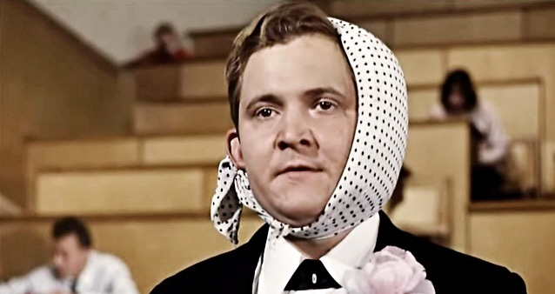
Opinion of students.

Slide 6
Our results.

Slide 7
Why dress code?

Slide 8
Statistic.

Slide 9
1)What do you think about wearing school uniform at school? 1.I think that it is bad idea.
2)Do you ask you parents and friends about uniform? 2.My parents and friends too think that it is bad idea.
3)Do you ask students in your school about it? 3.Yes I do. I ask students in my school about it.
4)How many people you are going to ask? 4.All people in school going to ask.
5)What results you are having now? 5.Now we have good results! All think that dress code better uniform.
6)Why people like more dress code than school uniform? 6.I think that dress code is very comfortable.
We asked 900 students, parents and teachers. 50 percent of students said that they wanted to go to school in everyday clothes Some part of parents supported they children, but 75 percent of parents wanted that all students wear official uniform. 80 percent of teacher said that school uniform were compulsory, because it’s very comfortable and could help to concentrate attention on learning. I support opinion of teachers, that students must wear school uniforms.

