Slide 1
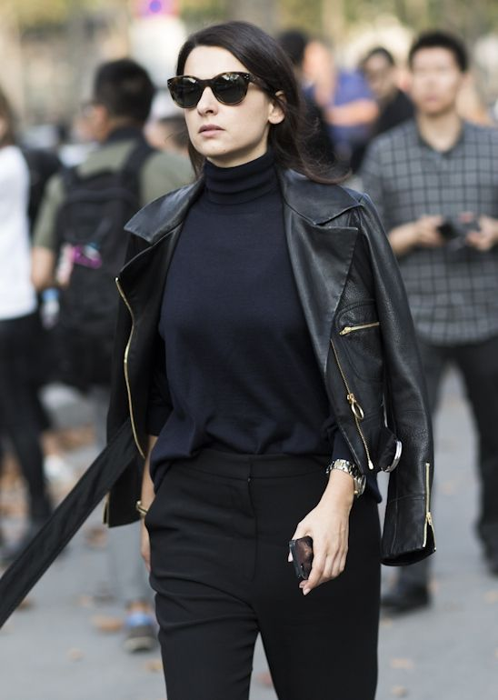
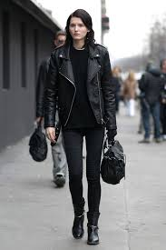
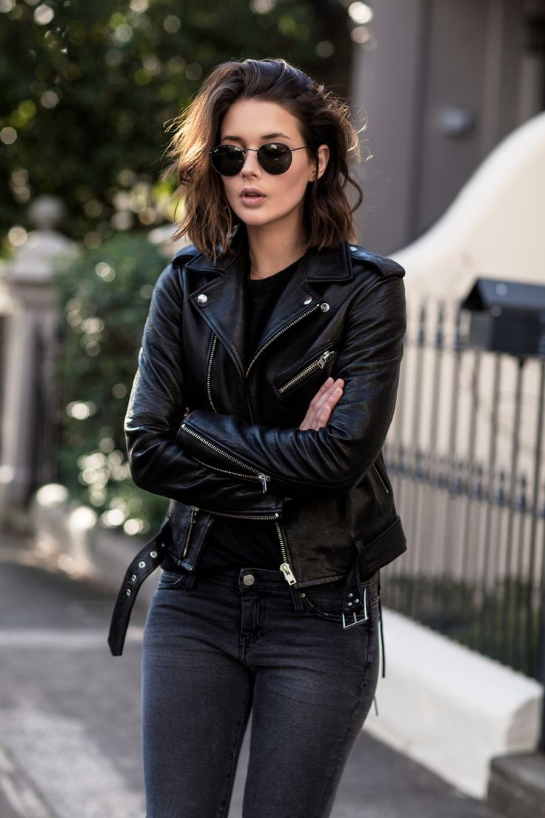
«Men in Black»
Made by: Mary Dener, Elina Valuycskaya, Lera
Grekova, Daria Kiryanova

Slide 2
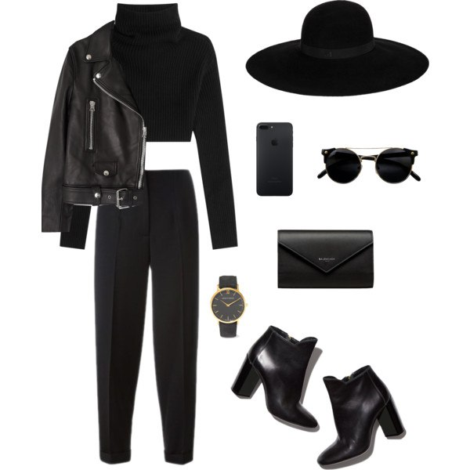
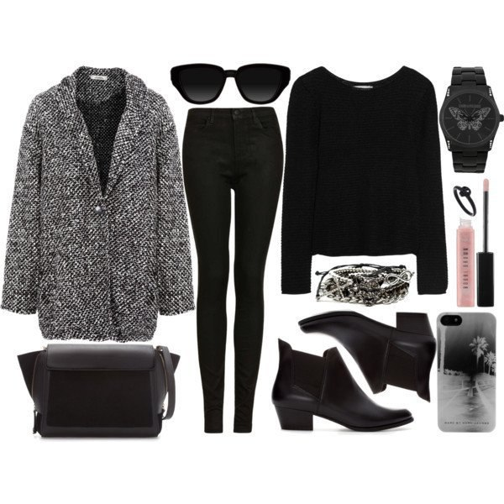
The classic style.
always fashionable

Slide 3
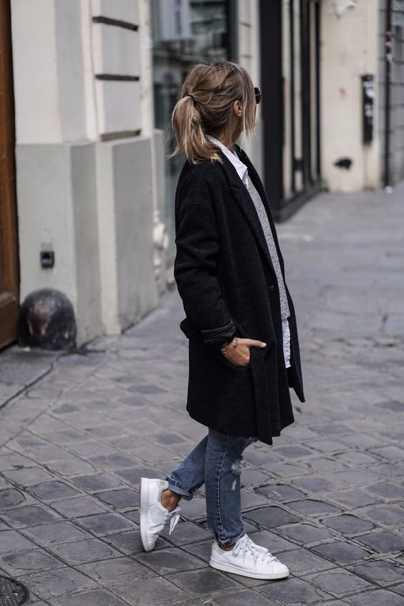
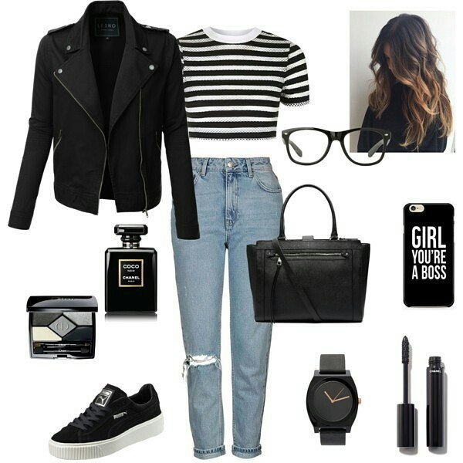
Casual style.
very comfortably

Slide 4
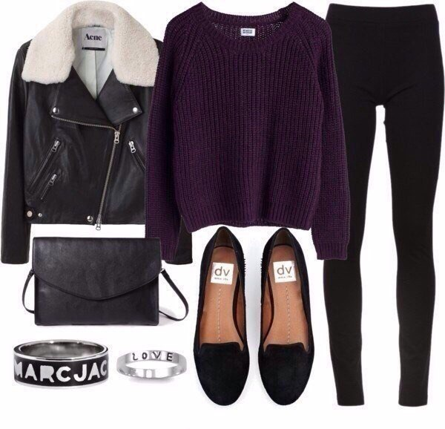
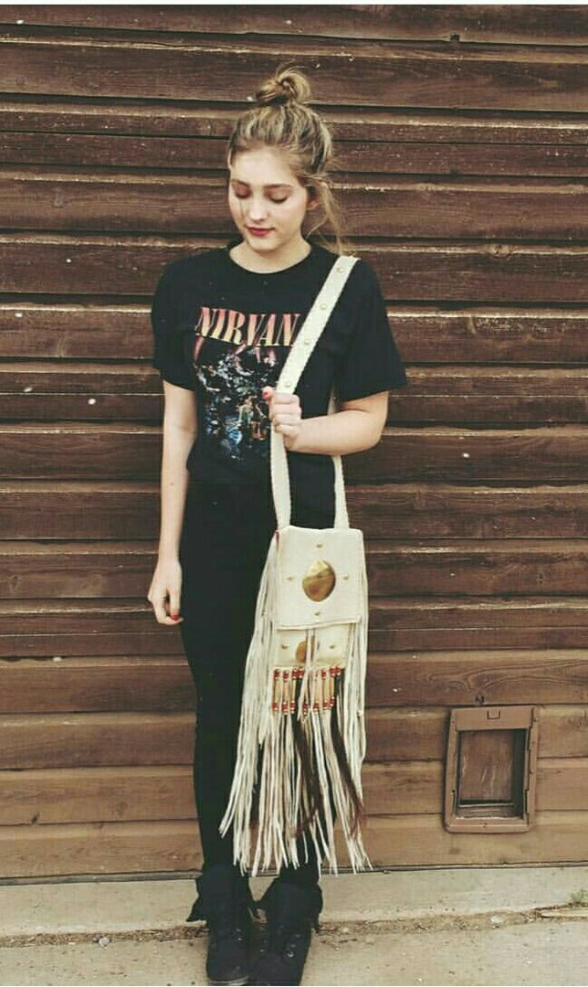
Rocker style.

Slide 5
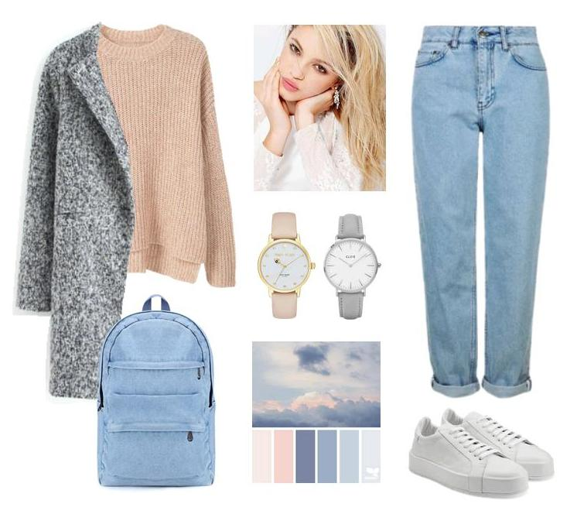
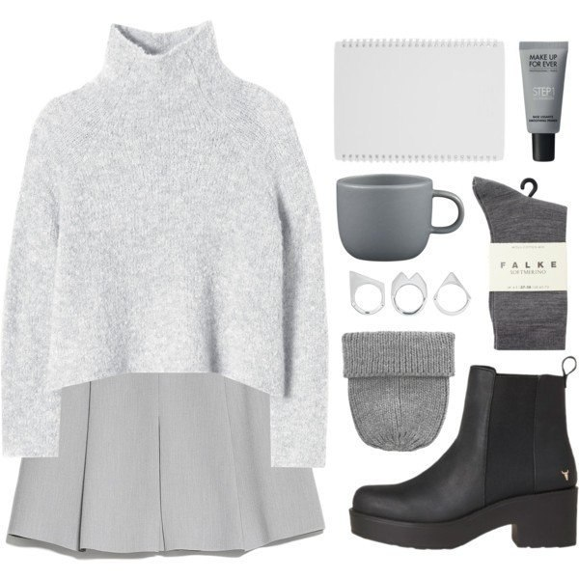
Oversize-style.

Slide 6
I prefer black shades in clothes. Most of all I like the classic style. It always remains relevant and fashionable. I believe that the classic style is appropriate in many situations. I love to combine short pants with any top. I really like the leather jacket and long coats. I like to combine classic style clothes with sneakers.
Oh, I agree with you. I like this style too, but I prefer jeans style. I think that jeans suit with all kinds of shoes, especially with white running shoes and sneakers. also with jeans, I like to wear sweaters, shirts, T-shirts and sweaters. you can choose any model of jeans that you like. Under the jeans fit all kinds of jackets and coats. I think that this style is versatile and look good to not have to buy expensive clothing brands.

Slide 7
I love dark colors, such as purple, black and gray. I would always wore dark clothes, but unfortunately it is not suited to all situations. I love to wear a T-shirt with my favorite rock bands, black leather jacket and a hat with a wide brim. What sways shoes, I would have just walked in sneakers the whole year, it is very unfortunate that in these cold winter. Also I like the strict classical style. For example black shoes without heels, shirt and dark trousers. It seems to me that both of these styles are now the fashion . And yet, as I have poor eyesight, I would like to have a lot of glasses - this is perhaps the most important part of my style.
I respect you preferences in clothing, but I'm still more like the clothes in light and pastel shades. I very like to wear jeans in Pale Blue and white colours, sweaters and pullovers of fine-knit in light colours. Even though I also wear the clothes in dark shades, but more rarely. Also I prefer to wear skirts of different lengths and models. As for shoes, I prefer flat shoes and boots with a wide heel, and, of course, sneakers. Finally I can say that the most important thing in my style is backpack or bag.

