Slide 1
Trojan war
Made:Edward Soldatkin
Makarov Yaroslav

Slide 2
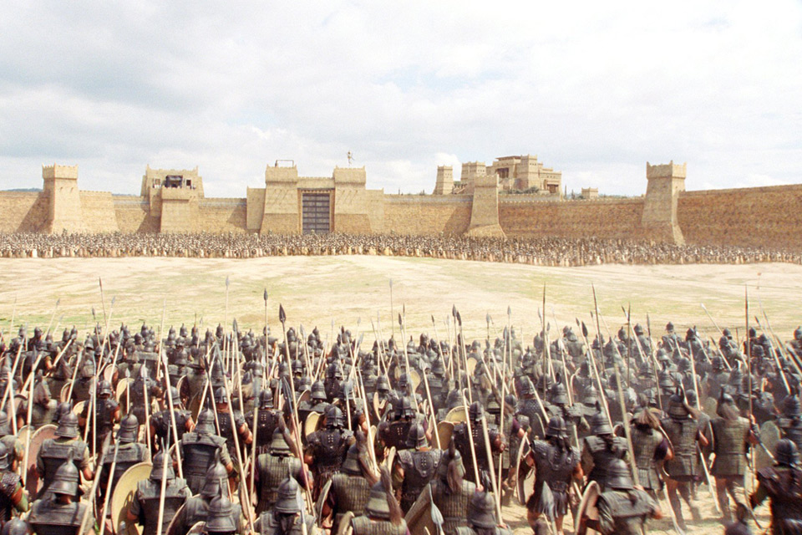
The outbreak of war

Slide 3
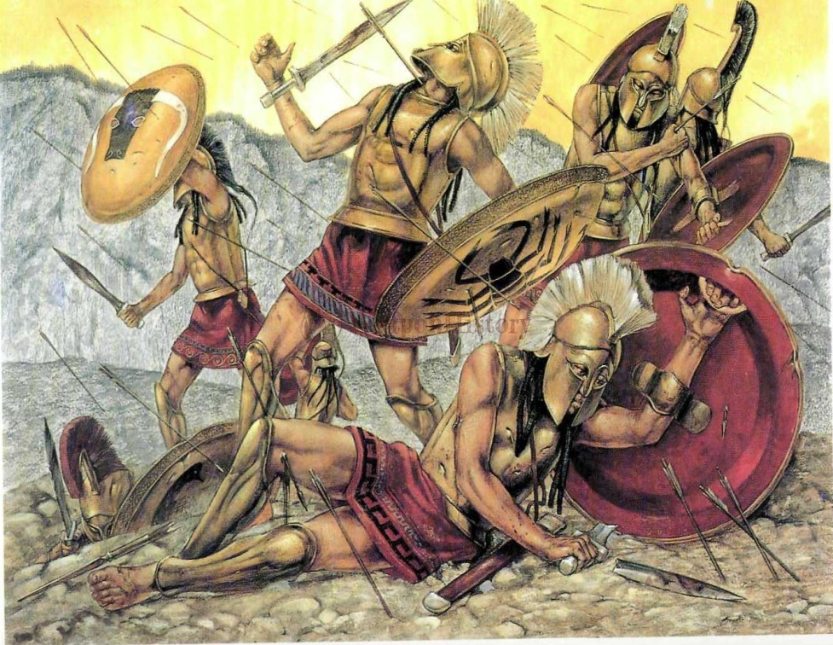
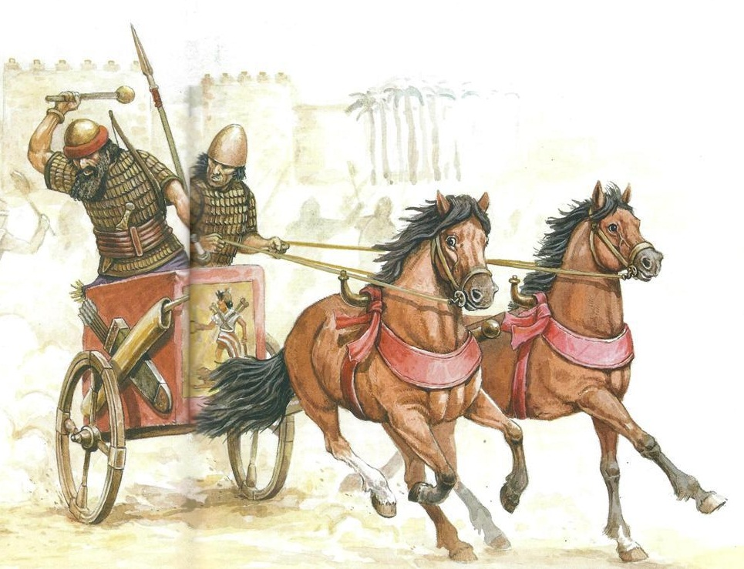
War of the Trojans and the Greeks

Slide 4
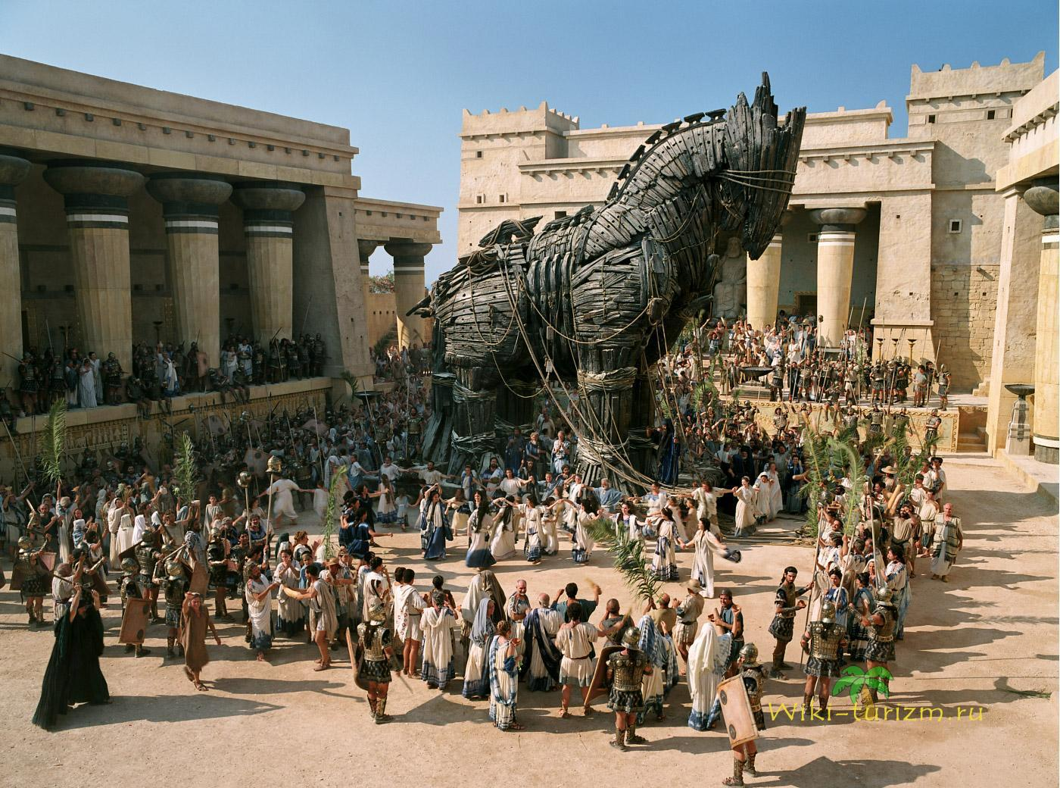
Trojan horse

Slide 5
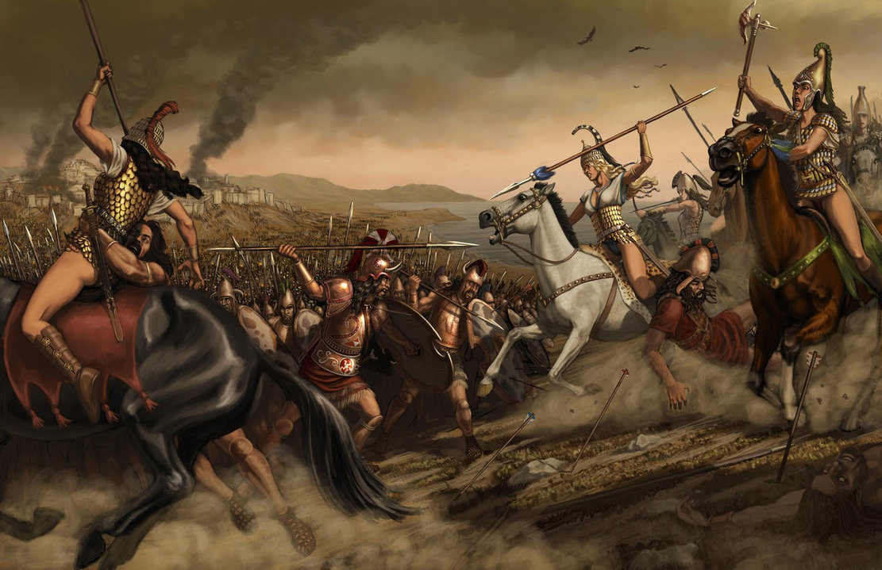
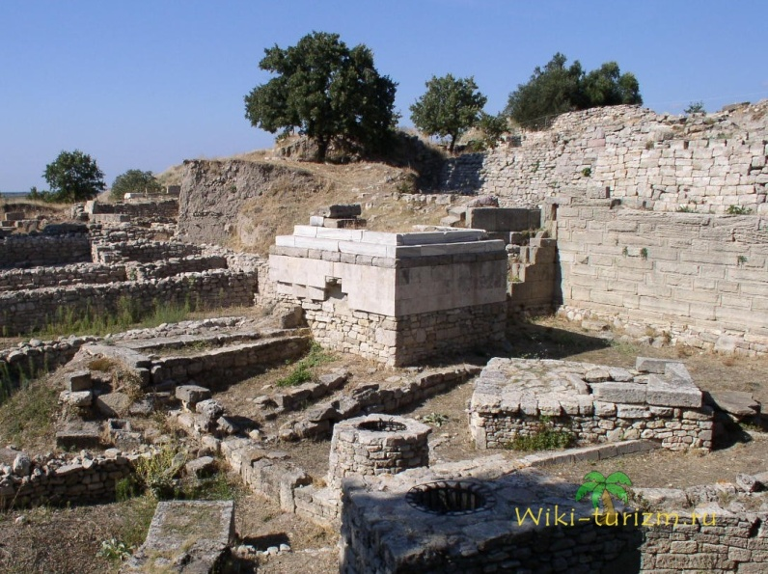
Troy at different times
Troy then
Troy is now

Slide 6
During excavations scientists have concluded that the first Troyan village was a Bunarbashi fortress and how archeologists think,it happened about 3000 years ago.As for the origin of Troyan that historians reading ancient Egiptian's and Greek manuscripts have learned that before the Troyan people called -"Teucers",who was very brave and warlike people.Also I can to say ,that all their achivments were gloriful not only in our modern films or TV programmes and in the Homer's poems such as "The Illiad" and "Odyssey".What i can to say about their life that it was a war,because the Troyan had very few allies and the most nations tried,by all means,to assign the territory of Troya because they were very convenient not only for trading but for the warfare doings against other nations.These people didn't know,what is it, quiet and peaceful life because all history of Troya was built on the bones of the dead soldiers who gave their lifes for the welfare future of their people,the same millitary and fearless as the gods themselves!
The first settlements found in Hissarlik was a fortress with a diameter of less than 100 m and, obviously, there were over a long period. During this period, Troy is a vast settlement, enclosed with strong walls with towers of the penalty. Major excavations of 1988 showed that the population of the city in Homer's era was between six and ten thousand inhabitants - at the time, a very impressive number. downtown area was approximately 170 thousand m², the citadel -. 23 thousand square meters. The first is known Troy died due to fire

