Slide 1
Environmental problems inKrasnodar Region
By: Lydia Martynenko and Poznyahovskaya Christina

Slide 2
It’s a wonderful world we live in.

Slide 3
But now human beings are killing our region.

Slide 4
The environment is characterized by significant environmental problems.

Slide 5
First and foremost is the river pollution and depletion of water resources.

Slide 6
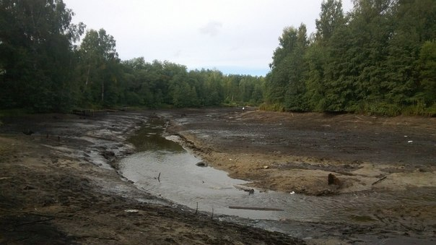
Small rivers dry up, overgrown with algae.

Slide 7
In the Krasnodar Region the river Kuban does not satisfy standards.

Slide 8
Another problem is soil erosion.

Slide 9
Even destroyed some natural monuments such as national parks.

Slide 10
In Krasnodar the atmosphere is polluted by emissions of sulphur and carbon, and heavy metals.

Slide 11
We can make a contribution: to throw litter into the bin, not to pluck flowers, save electricity and other resources

